Slide 1
Mosaic Planner with Micro-Manager
Array Tomography without Axiovision
Aaron Plave - Summer Project 2013

Slide 2
Current Array Tomography Workflow
Sectioning
Staining
10x mosaic creation in Axiovision
Generate position list using the original Mosaic Planner
63x image capture in Axiovision
Stitching and Registration

Slide 3
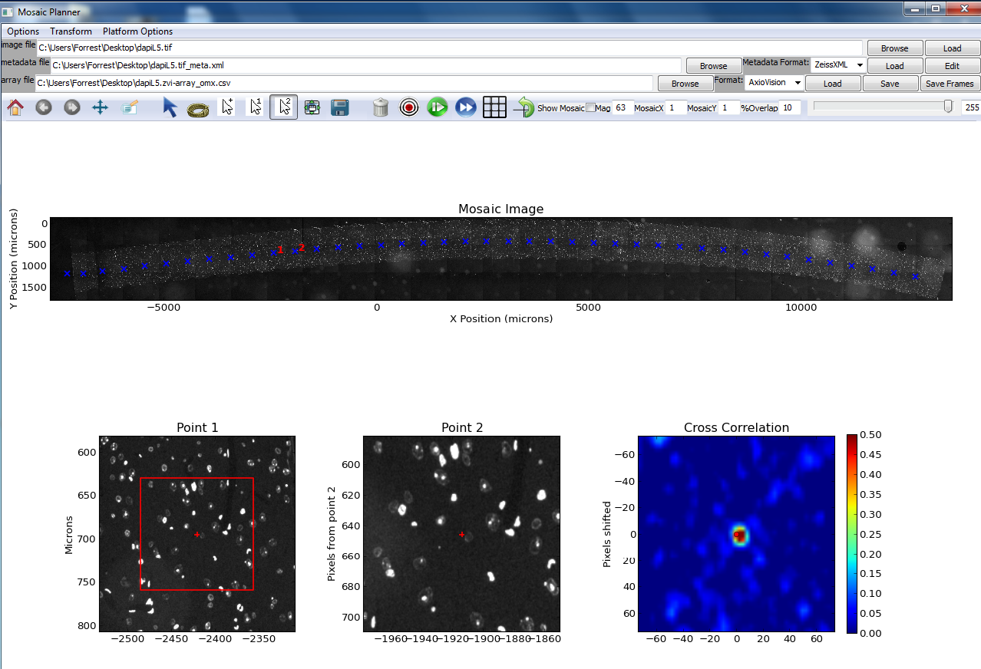
Current Mosaic Planner

Slide 4
New Array Tomography Workflow
(In Development)
Sectioning
Staining
Dynamically acquire images to generate a position list by integrating Mosaic Planner with Micro-Manager
63x image capture using Micro-Manager
Stitching and Registration

Slide 5
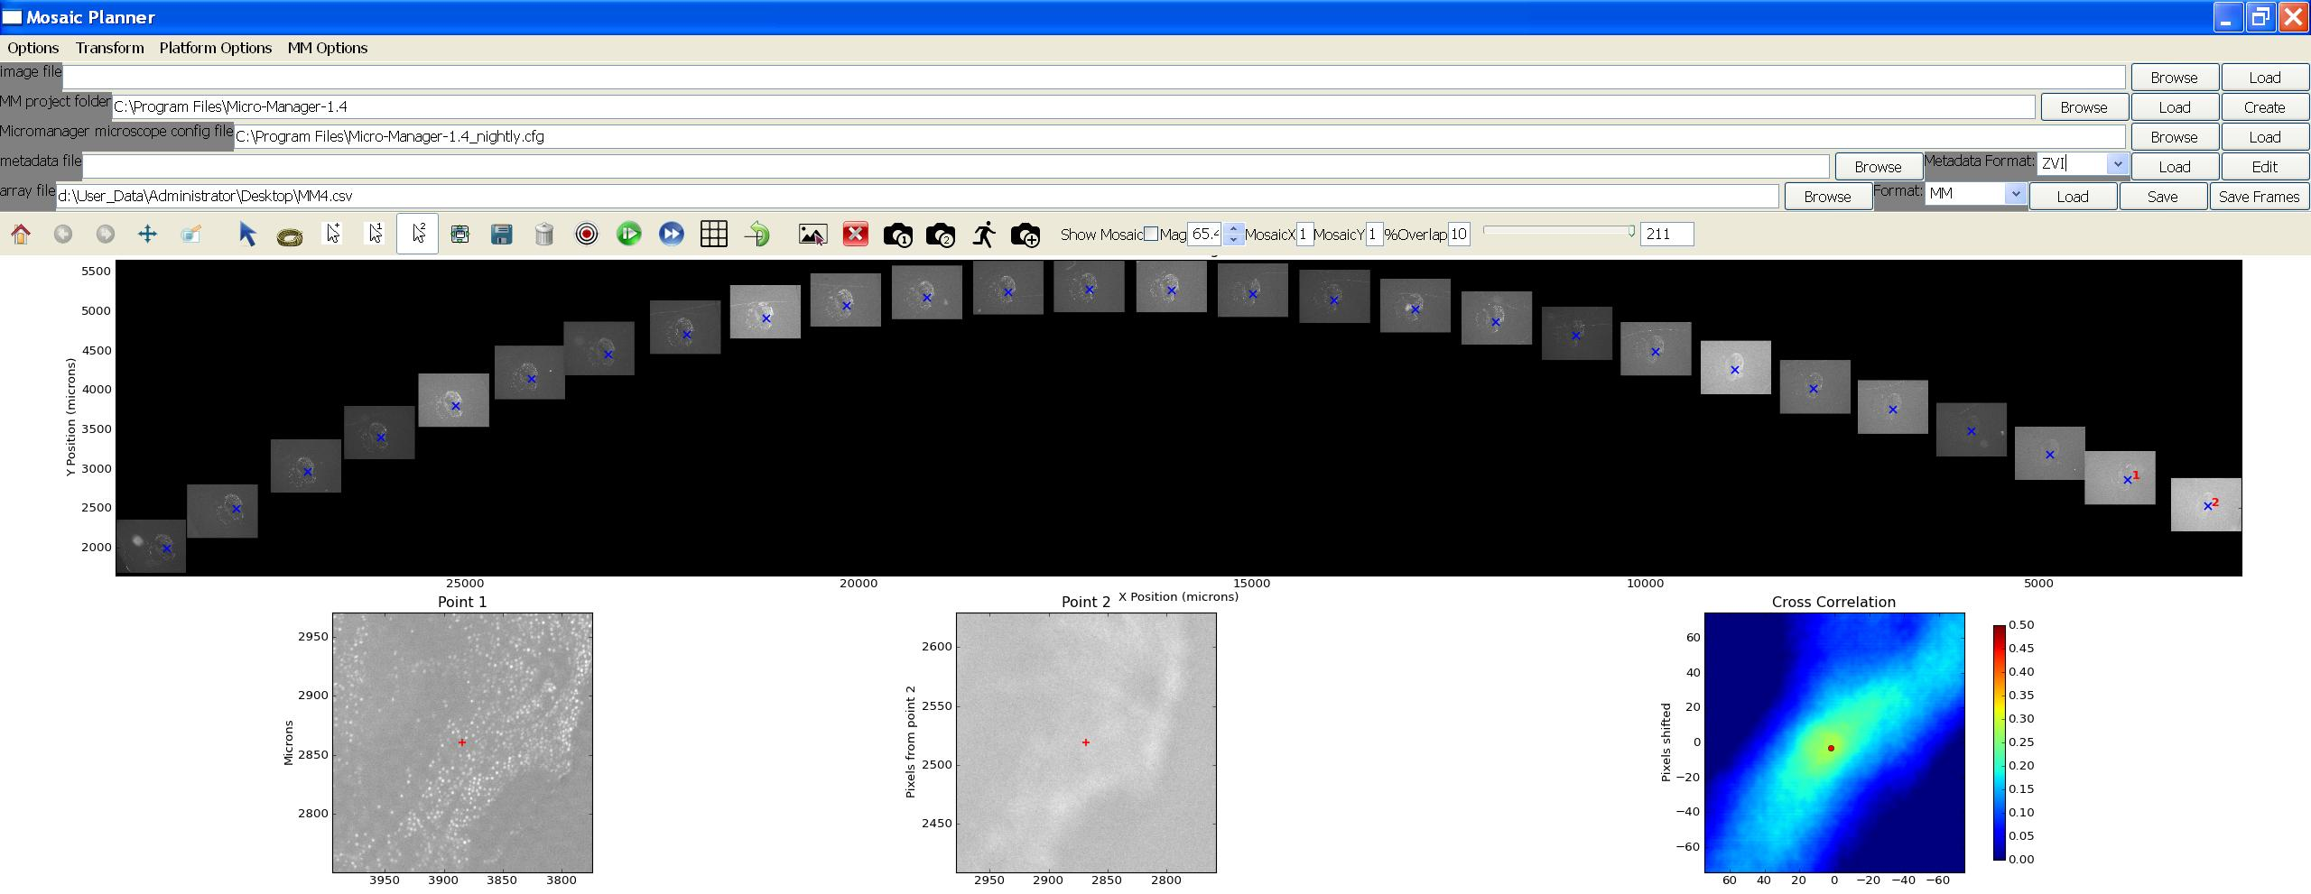
Mosaic Planner with Micro-Manager

Slide 6
Mosaic Planner with Micro-Manager Software
Mosaic Planner interfaces with the microscope and camera by using the API Micro-Manager provides to communicate with the hardware controls.
Brief overview of usage:
Load Micro-Manager microscope configuration
Acquire first two slice images manually
Automatically acquire the rest of the images on the slide by programmatically guessing the next position, snapping an image, and using cross-correlation to correct the position
Export position list in a Micro-Manager compatible format for use in 63x acquisition

Slide 7
Advantages
Fewer steps in the imaging process
Faster 10x position list generation (rate of ~30 seconds per slice position)
No tile stitching required until 63x tiles collected
Completely customizable code, settings, features such as:
Autofocus settings and algorithms
Anything you want to do with the microscope control wise
Open source Array Tomography, no more expensive Axiovision software necessary.
Array Tomography software independent of hardware– compatible with any Micro-Manager supported camera and microscope

Slide 8
Future Directions
Bug fixes
64 bit operating system compatibility
Mosaic Planner and Micro-Manager both work but there have been strange driver issues with the Zeiss camera. Should otherwise work in theory.
Add more features and test existing features
General code optimization
Better autofocus
Switch to a more robust GUI
Swap out current cross-correlation method for a better detection algorithm

Slide 9
Acknowledgements
Josh Zimmerberg
Brad Busse
Paul Blank
Forrest Collman, developer of Mosaic Planner
Arthur Edelstein, Henry Pinkard, and Nico Stuurman, lead developers for Micro-Manager

Slide 10
Project Source Code @ https://github.com/aplave/mosaic-planner-mm

